Slide 1
kidnapped in each and every state
Q1 What is the major reason people being kidnapped in each and every state?
Query:-
SELECT * from "39_Specific_purpose_of_kidnapping_and_abduction";
SELECT DISTINCT Area_Name,Sub_Group_Name,
sum (K_A_Female_Total) as Female_total,
sum(K_A_Male_Total) as Male_total,
sum (K_A_Grand_Total) as Total_male_female_kidnapping
FROM "39_Specific_purpose_of_kidnapping_and_abduction"
where Sub_Group_Name not like "%total%"
GROUP by Area_Name,Sub_Group_Name
ORDER by sum(k_a_grand_total) desc;

Slide 2
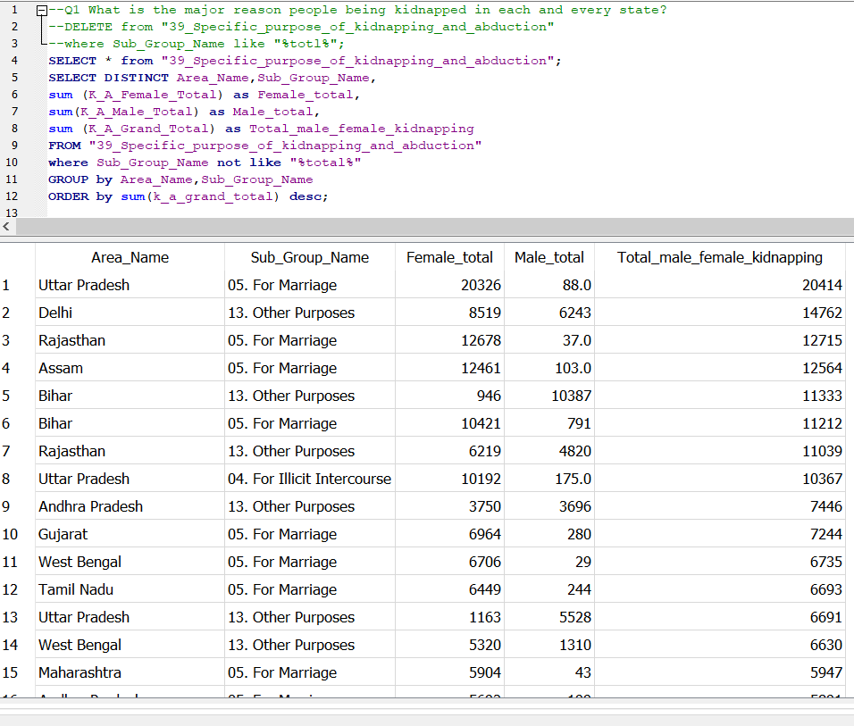
Our query screenshot:-

Slide 3
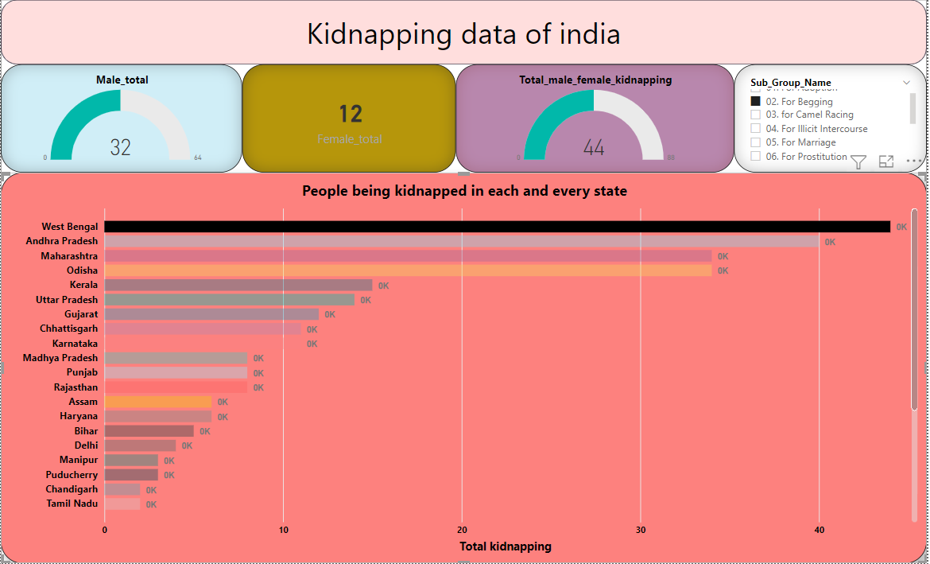
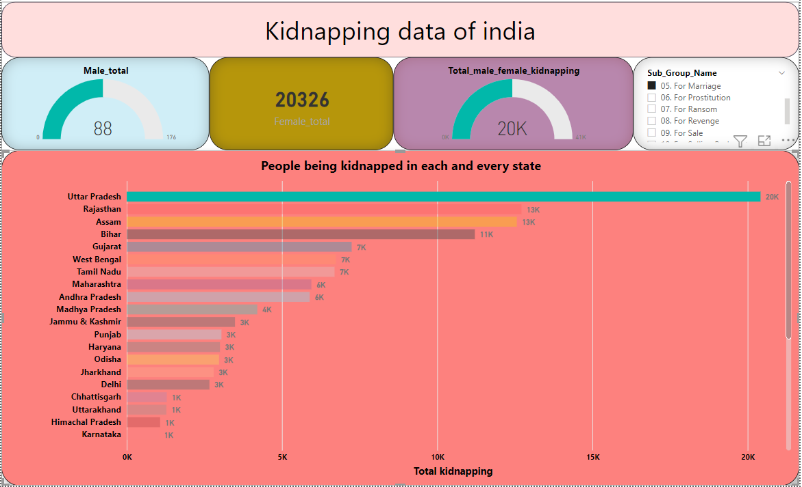
Conclusion:- 1. West Bengal's data is showing that most kidnappings do happen to make beggars. 2.The kidnapping that happens in Utter Pradesh is mostly for marriage.

Slide 4
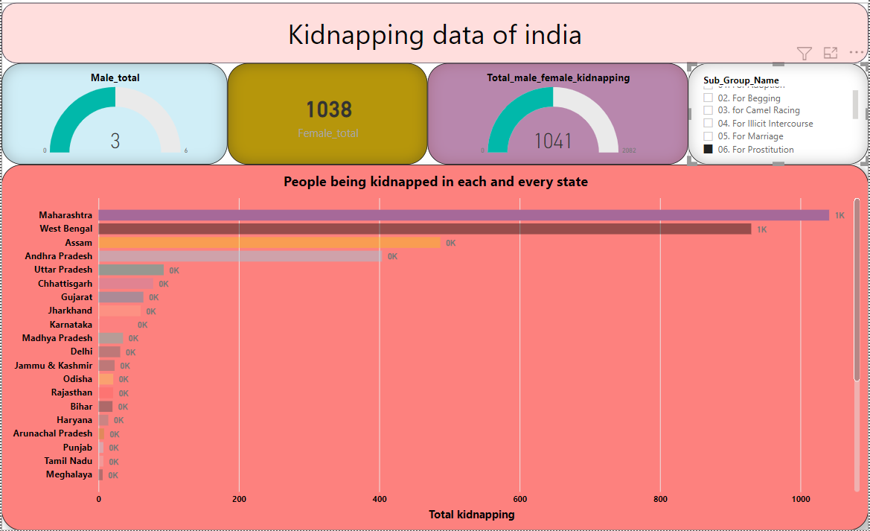
3.The number of female kidnapping for prostitution is highest in Maharashtra.

